Slide 1
CE 3372 Water Systems Design
DRINKING WATER storage Part 1 (FALL 2020)

Slide 2
Storage
Storage is used in water supply, storm water management, and wastewater systems for a variety of reasons.
SERVICE STORAGE
flow equalization — generally things are designed for a particular steady flow rate and storage can be used to accommodate variable flow rates in a system.
Pressure zone maintenance
EMERGENCY STORAGE
used to provide supply during repairs and other system interrupts
FIRE STORAGE
used to provide supply during fire fighting activities – could logically be considered as part of emergency
Storage is either elevated (above grade), at grade (reservoir, tanks, ponds, etc.) or below grade (subsurface vaults — NOT AQUIFERS).

Slide 3
Surface Reservoirs
Where natural elevation is high enough
For inexpensive pumped storage
Covered for protection (contamination, algae growth, evaporation)
Good temperature control

Slide 4
Standpipes
Vertical cylindrical pipe
Height > diameter
Useful storage = volume above elevation needed for minimum pressure
Low storage useful for emergencies
Steel, reinforced concrete

Slide 5
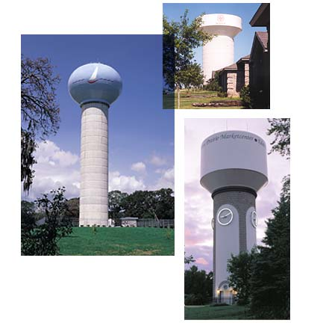
Composite Elevated Tanks

Slide 6
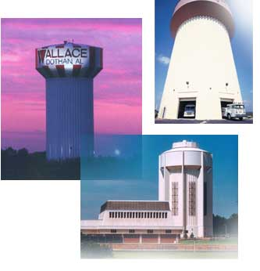
Hydropillar™

Slide 7
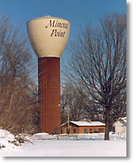
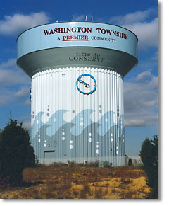
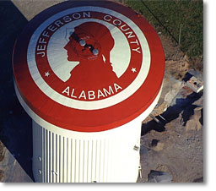
Hydropillar

Slide 8
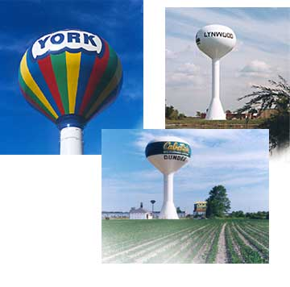
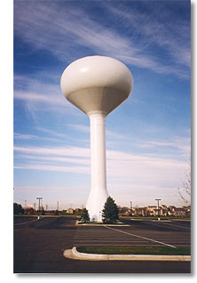
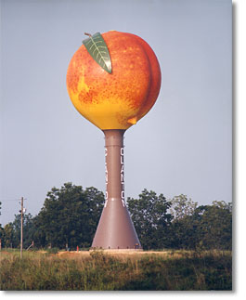
Water Spheroids

Slide 9
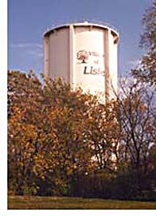
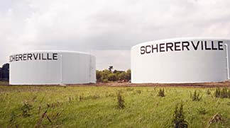
Standpipe Ground Level

Slide 10
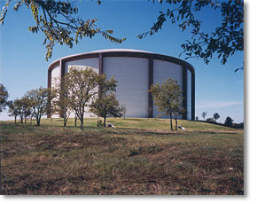
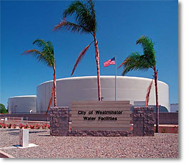
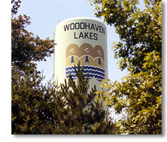
Standpipes and Reservoirs

Slide 11
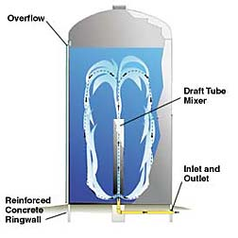
Freshmix™ Standpipe Mixing

Slide 12
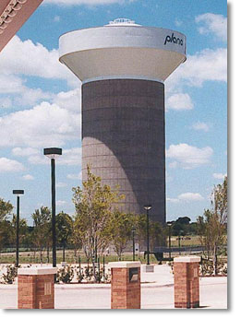
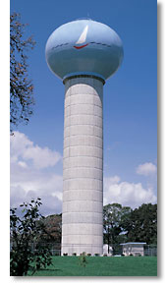
Composite Elevated Tanks
Standard CET Dimensions
Capacity (in U.S. gallons) | Tank Diameter (in feet) | Head Range (in feet) | Pedestal Diameter (in feet)
1,000,000 | 70 | 40 | 36
1,500,000 | 87 | 40 | 48
2,000,000 | 94 | 45 | 52
2,500,000 | 105 | 45 | 60
3,000,000 | 118 | 45 | 64

Slide 13
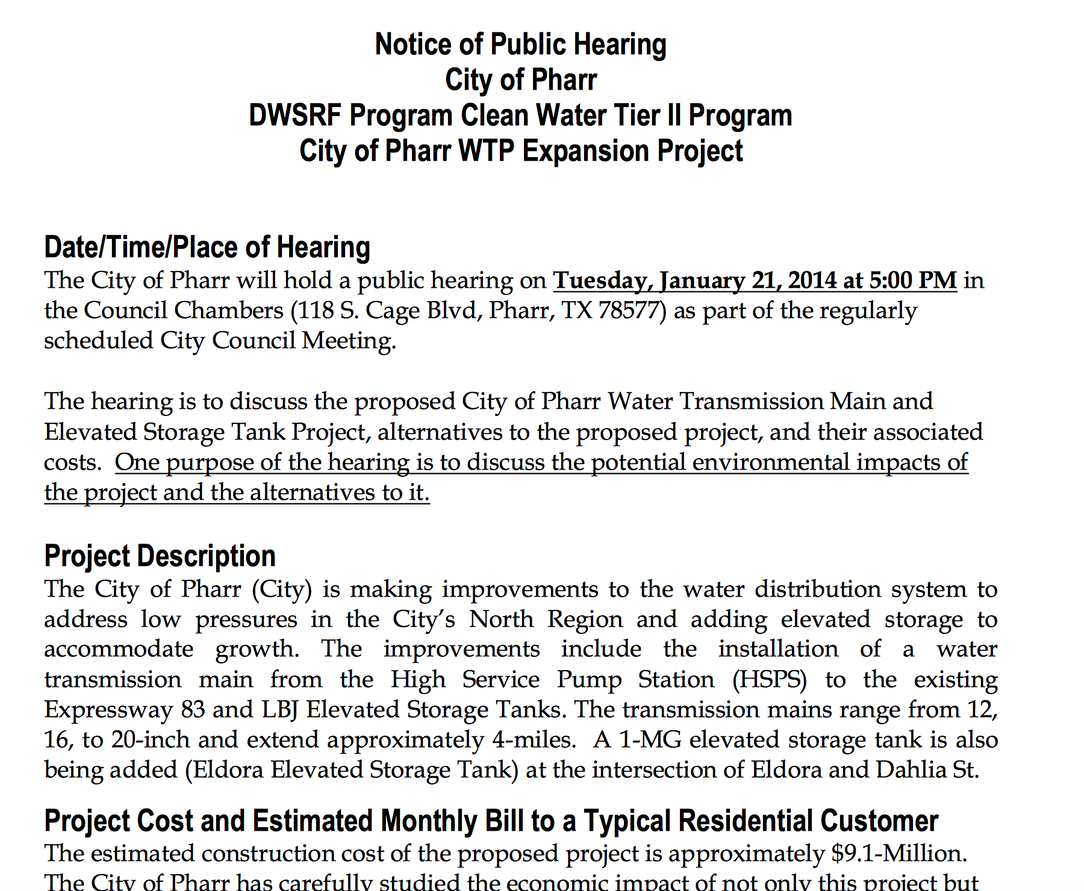
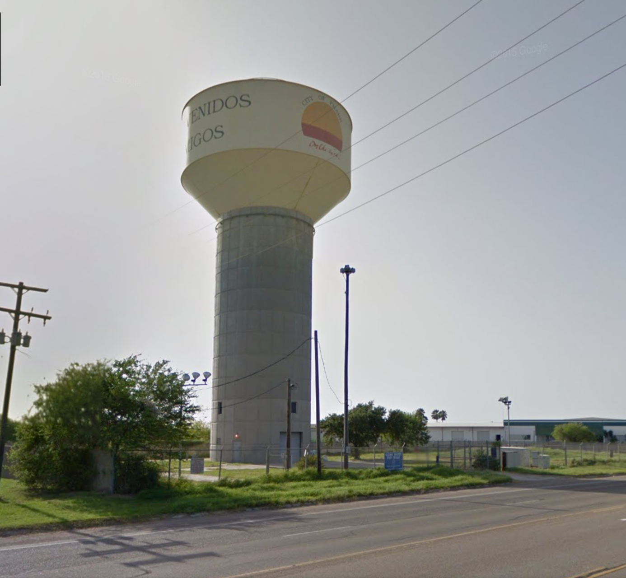
Typical installation

Slide 14
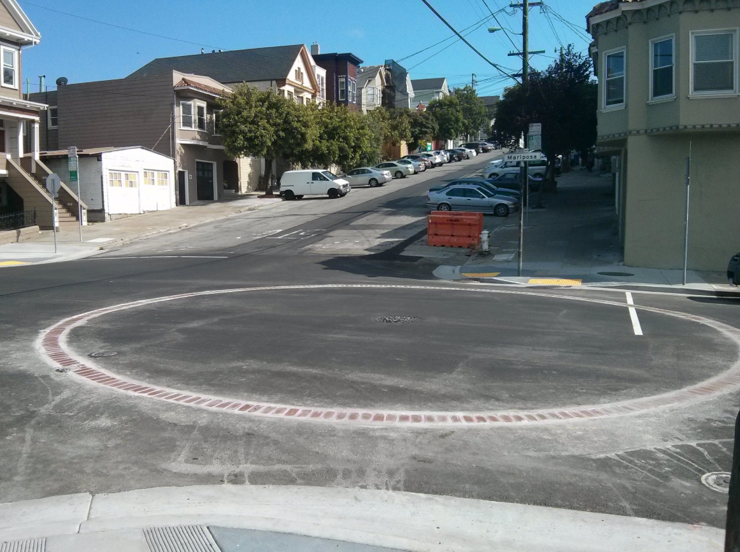
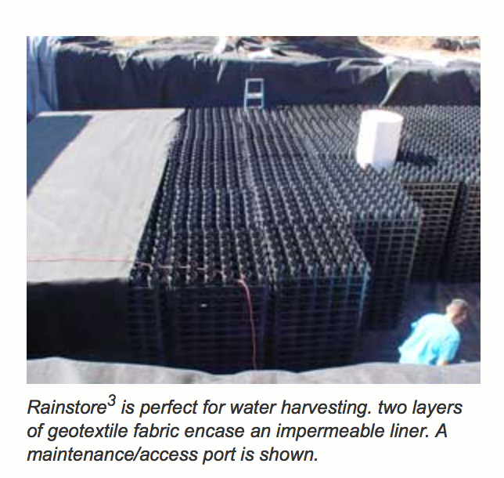
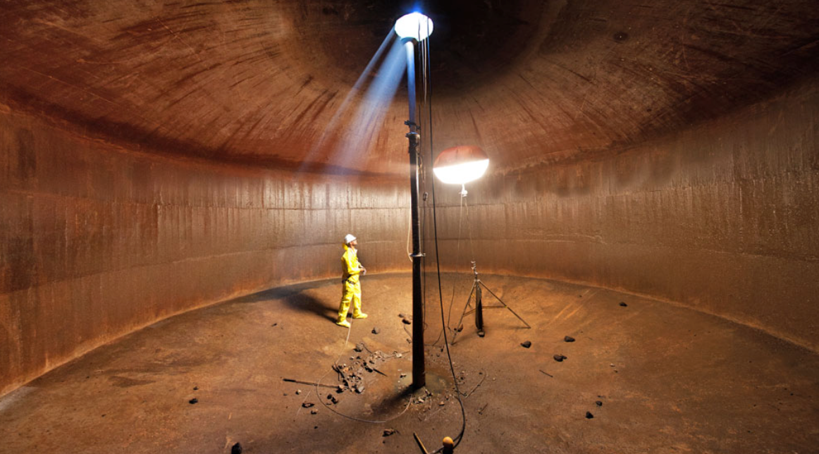
Underground “tank”
More than a hole in the ground
Needs structure to support surface loads
Needs a way to drain completely (usually a pump)

